Slide 1
2월 6일 보고서

Slide 2
str=''‘
RegExr v3 was created by gskinner.com, and is proudly hosted. by Media Temple.
Edit the Expression & Text! to see matches.
Roll? over matches or the expression% for details. PCRE & Javascript flavors of RegEx are supported.
The side bar includes a Cheatsheet, full Reference, and Help.
You can also Save & Share with the Community, and view patterns. you create# or favorite in My Patterns.
Explore results with the Tools below. Replace & List output~ custom results.
Details lists capture groups. Explain describes your expression in plain English'''

Slide 3
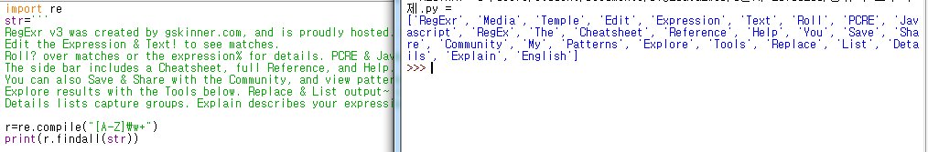
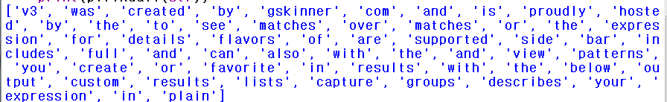
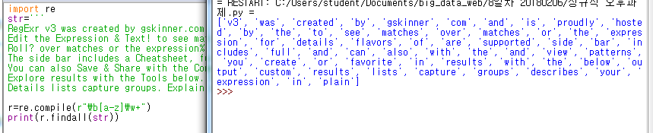
정규식으로 str에서 대문자로 시작하는 단어를 찾아 나열하시오.
정규식으로 str에서 소문자로 시작하는 단어를 찾아 나열하시오.
Notes:
import re
str='''
RegExr v3 was created by gskinner.com, and is proudly hosted. by Media Temple.
Edit the Expression & Text! to see matches.
Roll? over matches or the expression% for details. PCRE & Javascript flavors of RegEx are supported.
The side bar includes a Cheatsheet, full Reference, and Help.
You can also Save & Share with the Community, and view patterns. you create# or favorite in My Patterns.
Explore results with the Tools below. Replace & List output~ custom results.
Details lists capture groups. Explain describes your expression in plain English'''
r=re.compile("[A-Z]\w+")
print(r.findall(str))
import re
str='''
RegExr v3 was created by gskinner.com, and is proudly hosted. by Media Temple.
Edit the Expression & Text! to see matches.
Roll? over matches or the expression% for details. PCRE & Javascript flavors of RegEx are supported.
The side bar includes a Cheatsheet, full Reference, and Help.
You can also Save & Share with the Community, and view patterns. you create# or favorite in My Patterns.
Explore results with the Tools below. Replace & List output~ custom results.
Details lists capture groups. Explain describes your expression in plain English'''
r=re.compile(r"\b[a-z]\w+")
print(r.findall(str))

Slide 4
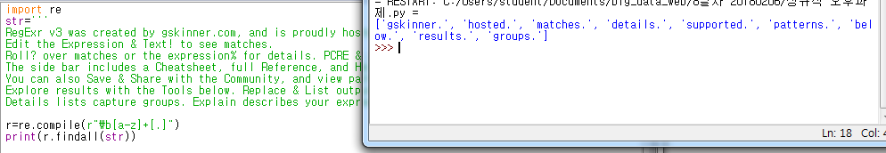
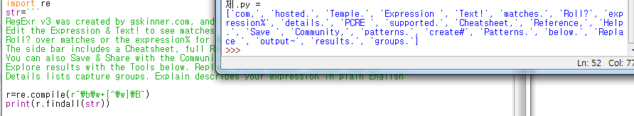
정규식으로 str에서 소문자로 시작하는 단어중 .로 끝나는 단어를 찾아 나열하시오.
정규식으로 str에서 특수기호로 끝나는 단어를 찾아 나열하시오.
Notes:
import re
str='''
RegExr v3 was created by gskinner.com, and is proudly hosted. by Media Temple.
Edit the Expression & Text! to see matches.
Roll? over matches or the expression% for details. PCRE & Javascript flavors of RegEx are supported.
The side bar includes a Cheatsheet, full Reference, and Help.
You can also Save & Share with the Community, and view patterns. you create# or favorite in My Patterns.
Explore results with the Tools below. Replace & List output~ custom results.
Details lists capture groups. Explain describes your expression in plain English'''
r=re.compile(r"\b[a-z]+[.]")
print(r.findall(str))
import re
str='''
RegExr v3 was created by gskinner.com, and is proudly hosted. by Media Temple.
Edit the Expression & Text! to see matches.
Roll? over matches or the expression% for details. PCRE & Javascript flavors of RegEx are supported.
The side bar includes a Cheatsheet, full Reference, and Help.
You can also Save & Share with the Community, and view patterns. you create# or favorite in My Patterns.
Explore results with the Tools below. Replace & List output~ custom results.
Details lists capture groups. Explain describes your expression in plain English'''
r=re.compile(r"\b\w+[^\w]\B")
print(r.findall(str))

Slide 5
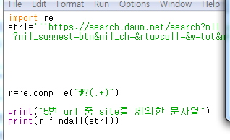
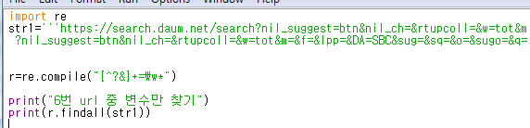
str1='''https://search.daum.net/search?nil_suggest=btn&nil_ch=&rtupcoll=&w=tot&m=&f=&lpp=&DA=SBC&sug=&sq=&o=&sugo=&q=reg
?nil_suggest=btn&nil_ch=&rtupcoll=&w=tot&m=&f=&lpp=&DA=SBC&sug=&sq=&o=&sugo=&q=reg
'''
정규식으로 str1에서 url중 site를 제외한 문자열을 찾아 나열하시오.
정규식으로 str1에서 url중 변수만 찾아 나열하시오.
Notes:
import re
str1='''https://search.daum.net/search?nil_suggest=btn&nil_ch=&rtupcoll=&w=tot&m=&f=&lpp=&DA=SBC&sug=&sq=&o=&sugo=&q=reg
?nil_suggest=btn&nil_ch=&rtupcoll=&w=tot&m=&f=&lpp=&DA=SBC&sug=&sq=&o=&sugo=&q=reg'''
r=re.compile("\?(.+)")
print("5번 url 중 site를 제외한 문자열")
print(r.findall(str1))
import re
str1='''https://search.daum.net/search?nil_suggest=btn&nil_ch=&rtupcoll=&w=tot&m=&f=&lpp=&DA=SBC&sug=&sq=&o=&sugo=&q=reg
?nil_suggest=btn&nil_ch=&rtupcoll=&w=tot&m=&f=&lpp=&DA=SBC&sug=&sq=&o=&sugo=&q=reg'''
r=re.compile("[^?&]+=\w*")
print("6번 url 중 변수만 찾기")
print(r.findall(str1))

Slide 6
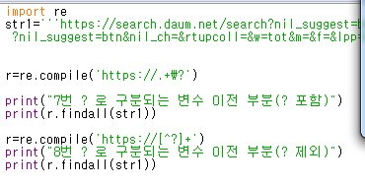
정규식으로 str1에서 ?로 구분되는 변수 이전 부분을(? 포함) 출력하시오.
정규식으로 str1에서 ?로 구분되는 변수 이전 부분을(? 제외) 출력하시오.
Notes:
import re
str1='''https://search.daum.net/search?nil_suggest=btn&nil_ch=&rtupcoll=&w=tot&m=&f=&lpp=&DA=SBC&sug=&sq=&o=&sugo=&q=reg
?nil_suggest=btn&nil_ch=&rtupcoll=&w=tot&m=&f=&lpp=&DA=SBC&sug=&sq=&o=&sugo=&q=reg'''
r=re.compile('https://.+\?')
print("7번 ? 로 구분되는 변수 이전 부분(? 포함)")
print(r.findall(str1))
r=re.compile('https://[^?]+')
print("8번 ? 로 구분되는 변수 이전 부분(? 제외)")
print(r.findall(str1))

